Slide 1
Access Center Assessment Report
Heather Novak
Research Manager, Institutional Research
March 2017

Slide 2
Assessment Questions
How does the Access Center contribute to access to Higher Education?
How does the Access Center contribute to access and diversity at CSU?
How does the Access Center contribute to student success at CSU?
Student Success is measured across the following metrics:
Persistence to 2nd fall
Persistence to 3rd fall
6-year graduation
Proportion of students that complete 30 credits in their first year
Proportion of students that maintain a 2.5 GPA in their first year
First year probation rate

Slide 3
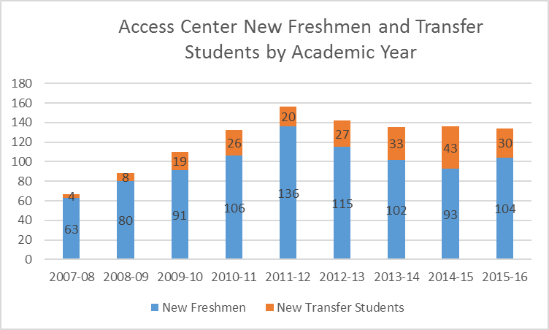
Access Center Assessment Population
Notes:
There are a total of 890 Access Center new freshmen and 210 Access Center transfer students included in this report’s analysis. Access Center results are compared to a group of non-Access Center students and internally across the type of programing. Collegiate programs include the summer Bridge students and Pre-Collegiate prep programs include upward bound, talent search and Alliance. The Education transition programs include EOC and EOC partnership.
Please note that this analysis is not limited to fall starts since only 80% of Access Center first-time students (or freshmen) start in a fall semester compared to 98% of non-Access Center freshmen. Among transfer students, the rate of fall starts is more comparable between Access Center and non-Access Center transfer students (72% compared to 74%). Outcomes are adjusted based on the students’ first semester; thus, the second fall for students who start in spring 2011 is fall 2012, the second fall for students that start in fall 2011 or summer 2011 is also fall 2012.

Slide 4
Access Center Demographics
Freshmen
Transfer
Average index of 111 (compared to 114 overall)
Majority FG, Pell and/or student of color
91% are either FG, Pell and/or student of color (compared to 44%)
Average index of 102 (compared to 105 overall)
Majority FG and/or Pell
41% students of color (compared to 15%)
91% are either FG, Pell and/or student of color (compared to 55%)
Notes:
The representation of first generation, minority or Pell recipients is much higher among Access Center students compared to the non-Access Center students for both freshmen and transfer students. Additionally, the average index and ACT scores are much lower in the Access Center group. Another key difference between the groups is that over 90% of the Access Center freshmen and transfer are either first generation, minority, or Pell recipients compared to 44% and 55% of non-Access Center freshmen and transfer students.

Slide 5
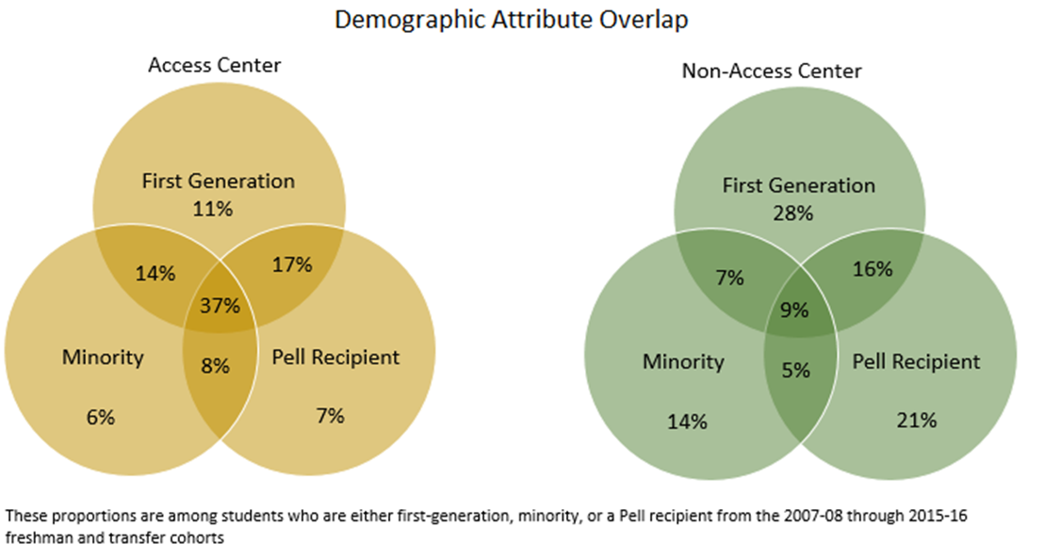
Notes:
Across students that have any of the three attributes, a much larger proportion of Access Center students have all three attributes or two of the three attributes. For instance, 37% of the Access Center population has three of the attributes (compared to 9% of non-Access Center) and 76% of the Access Center population has at least two of the attributes (compared to 37% of non-Access Center). The Access Center intentionally serves populations of students that historically have been underrepresented at CSU and the demographic profile of both freshman and transfer Access Center students reflects this purpose. However, when assessing the success of Access Center students the comparison level should reflect students with similar intersectionality and admission’s test scores.
As shown in the demographic section, Access Center students are demographically distinct from the overall population at CSU so comparisons for student success need to account for these demographic differences. In order to create a comparison group for both freshmen and transfer non-Access Center students a logistic regression model is run to predict the likelihood of being in the Access Center. The non-Access Center comparison groups for freshmen and transfer students are limited to just those who have a statistically similar probability of being in the Access Center. This model is based on the intersection of first generation, minority, and Pell recipient status as well as gender, semester of start (Fall vs Spring vs Summer), and then for the freshman model ACT scores and high school GPA are also included.

Slide 6
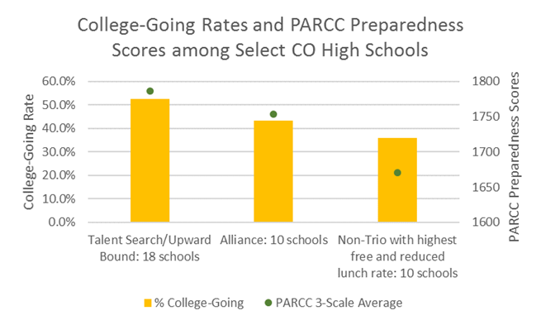
College Access
Notes:
Similar to the admit and yield rates, the college going rate (proportion of a high school’s graduating seniors that matriculate to higher education) is highest for CSU Talent Search / Upward Bound high schools followed by the Alliance high schools and lowest for the non-TRIO Colorado high schools with high free and reduced lunch rates. The PARCC preparedness score is positively correlated (.83 correlation) with the college going rate; therefore, the difference in college going for CSU Access Center high schools and non-TRIO high schools is partially explained by student preparedness regardless of Access Center activities.

Slide 7
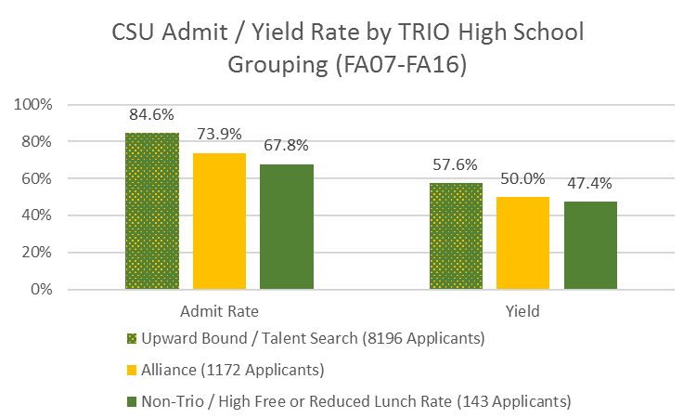
Access to CSU
Notes:
The admit and yield rates are highest for students from the Upward Bound and Talent Search high schools, but students from Alliance high schools still have higher rates than students from the non-TRIO comparison schools (10 CO high schools with the highest rates of free and reduced lunch). These results suggest that CSU TRIO and Alliance program participation is associated with high schools that have higher admit and enroll rates.

Slide 8
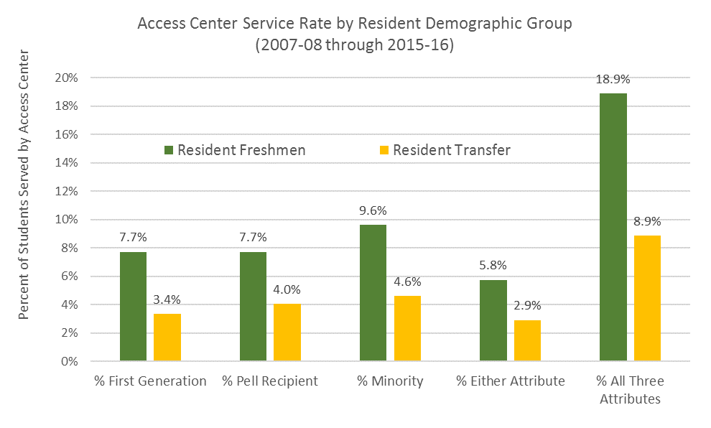
Diversity at CSU

Slide 9
Freshmen Student Success
Notes:
Statistically there are no differences between 2nd fall or 3rd fall persistence rates between Access Center freshmen and the matched freshmen group. The Access Center graduation rate is statistically lower than the comparison group (χ²=6.9; p=.009). About 55% of Access Center students from the 2007-08 through 2009-10 cohorts graduated in 6 years compared to 64% of the matched group. There is also a statistically significant difference in the proportion of Access Center students that are on probation during the first year compared to the matched group (χ²=6.2; p=.013). For instance, nearly 18% of Access Center students are on probation at the end of their first year compared to only 13% of the matched group. There are not differences in the proportions of students that complete 30 credits in the first year or in the proportion that maintain a 2.5 GPA or higher in the first year by Access Center status.
Across the Access Center’s programs, the GPA and probation rates are best for the Educational Transition Programs, but the persistence and graduation rates for this group is lower. The persistence and graduation rates are highest for the Pre-Collegiate programs. The success outcomes for Access Center students is provided by specific program (rather than the broader grouping presented) in Table A.1 of the Appendix. Additionally, these success measures are also provided by several select Access Center high schools in table A.3 of the Appendix.

Slide 10
Transfer Student Success
Notes:
The 2nd and 3rd fall persistence rates for Access Center Transfer students are statistically higher than the rates among the matched transfer group (χ²=3.9 & 4.9; p=.047 & .027). For instance, nearly 87% of Access Center transfer students persisted to their second fall semester compared to only 79% of the matched group. The observed 6 year graduation rate for the Access Center is also higher than the matched group; although, this difference or the differences by first year academic behavior metrics are not statistically significant.
Across the Access Center programs, the persistence and graduation rates are highest among the Pre-Collegiate programs (similar to the freshmen), but the proportion of students maintaining a 2.5 GPA is higher among the Educational Transition Programs. The transfer student outcomes can be viewed by specific program in table A.2 in the Appendix.

Slide 11
Conclusions
The students served by the Access Center are very diverse and have lower than average levels of high school preparation
There are positive correlational associations between Access Center partnerships and access outcomes
There are higher rates of students going to college at the high schools that have relationships with the Access Center
There are higher CSU yield and admit rates for students from Access Center high schools
The results are mixed for student success at CSU
There does not appear to be higher levels of student success for Access Center freshmen compared to a statistically similar group
There does appear to be higher levels of student success for Access Center transfer students compared to a statistically similar group

Slide 12
Bigger CSU Context
What is the contribution of the Access Center in terms of student gaps?
What is the contribution of the Access Center in terms of the C4E programs?
What other outcomes would help to tell the Access Center story?
Methodological approaches that approximate a good comparison group are limited…
Are there ways that the Access Center can improve these quantitative outcomes?
Notes:
A lack of demonstrative effectiveness as justification for cutting funding….
Are there better outcomes for Access Center programs?
Methodological approaches are limited in their ability to account for the variety of reasons programs might not look effective, so how can we better tell our story?
Are there ways to improve these quantitative outcomes?

